Slide 1




Rockbuster stealth LLC Sales Analysis Feb. 2007 – May 2007
Presented by Matthew Abrams

Slide 2
Project Overview
Motivation
Rockbuster Stealth LLC is facing stiff competition from streaming services such as Netflix and Amazon Prime. To keep up with competition, the company management team plans to use its existing movie licenses to launch an online video rental service.
Objective
Develop a launch strategy for the new online video service.
Scope
Rockbuster Stealth LLC is a movie rental company that used to have stores around the world.

Slide 3
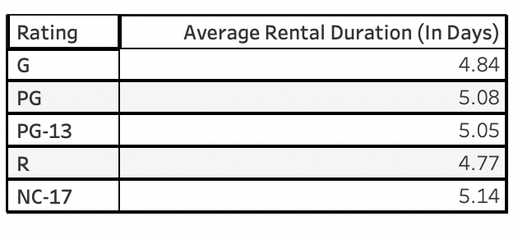
Average Rental duration for all videos
Between February 2007 and May 2007, people worldwide have rented each movie from Rockbuster 4 to 6 days on average.

Slide 4
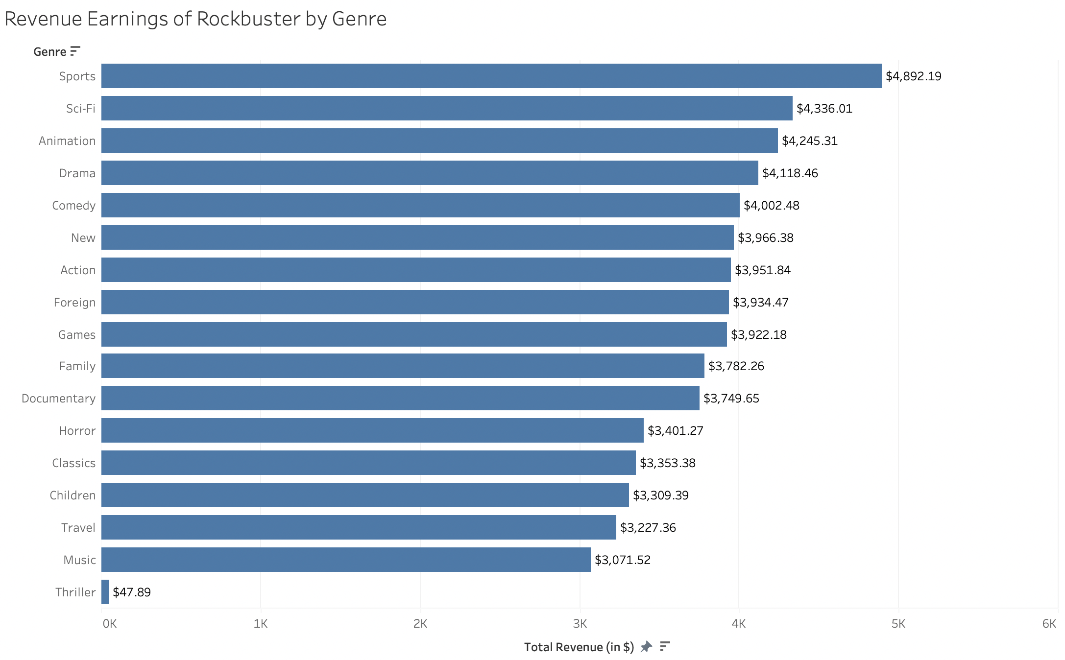
What Genres contributed the most/least to revenue gain?
Rockbuster makes the most revenue worldwide from genres like Sports, Sci-Fi, Animation, Drama, and Comedy.
Rockbuster makes the least revenue worldwide from genres like Horror, Classics, Travel, Music, and Thriller.

Slide 5
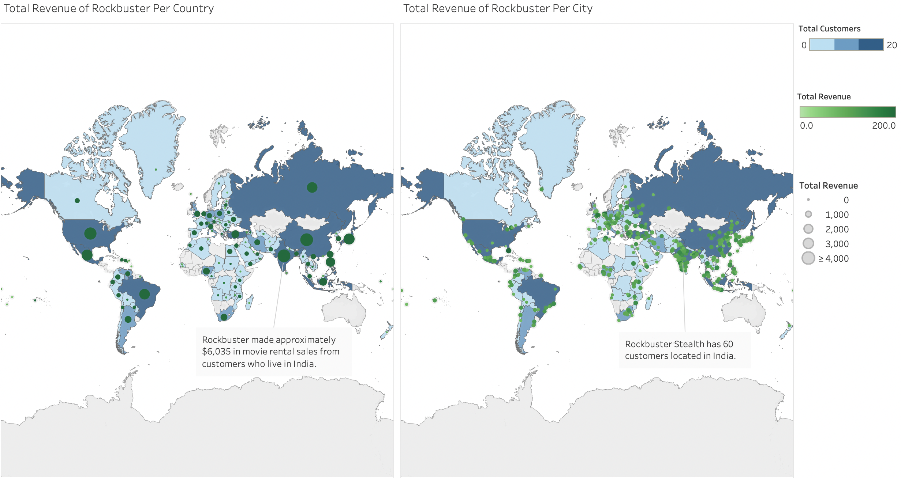
Do Sales figures vary between geographic regions?
The visualization on the left shows the total revenue in films rented from Rockbuster by country.
The visualization on the right show the total revenue in films rented from Rockbuster by city.
Rockbuster received the highest revenue from India due to having the greatest number of customers living there.

Slide 6
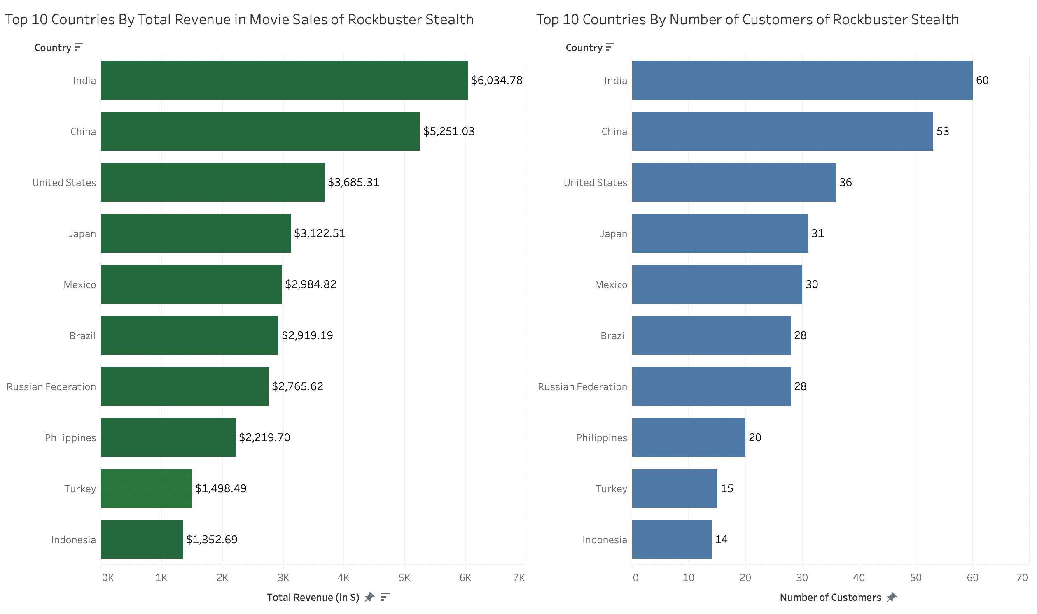
Which countries are rockbuster customers based in?
The visualization on the left show the top 10 countries by total sales in movies.
The visualization on the right show the same countries where customers are mostly based in.
There is a connection between the number of customers and total revenue per country considering both visualizations have the same listings in the same order.

Slide 7
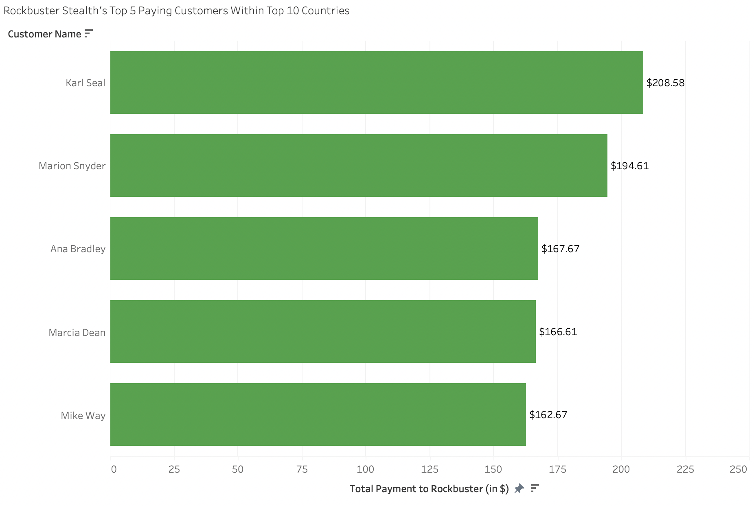
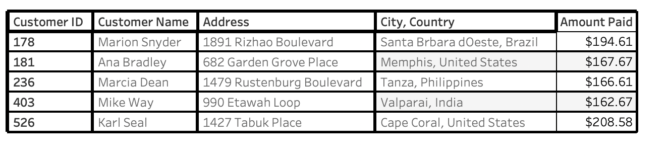
Let’s Reward These Most Loyal Customers
These 5 customers of the top 10 countries have spent the most money on rented films from Rockbuster.
The total amount paid by these 5 customers average to approximately $180 a person.

Slide 8
Recommendations/Next Steps
Start expanding company online headquarters in India, China, United States, Japan, Mexico, Brazil, Russian Federation, Philippines, Turkey and Indonesia where they also have the most Rockbuster customers.
Reward the following customers for their loyalty: Marion Snyder, Ana Bradley, Marcia Dean, Mike Way, and Karl Seal. Suggested rewards can include a 20% discount off their next 10 rental movies or a free Rockbuster Stealth LLC $15 gift card. Reach out encouraging these people to refer their friends and family to rent movies online from Rockbuster.
Rockbuster should stock more recent films of different genres such as Sports, Sci-Fi, Animation, Drama, and Comedy.
For countries having little to no sales in movie rentals from Rockbuster, reach out to those through surveys on where people get their entertainment from. Develop ad campaigns, including those countries who do not have any Rockbuster customers.
Let people know when paying for rental movies online they can be saved for 5 days. This would give people the opportunity to view them as many times as they want to during the rental period.

Slide 9
Any Questions?

